Slide 1
Explore the Kaggle Survey Data
MIE 1624 Assignment #1
Name: Jiani Jia
Student ID: 1002226245

Slide 2
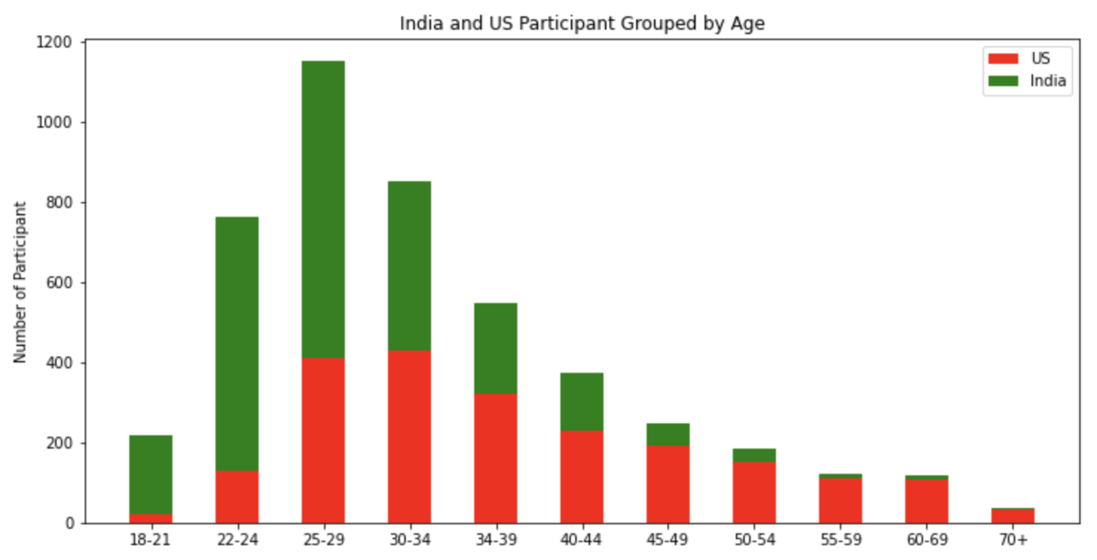
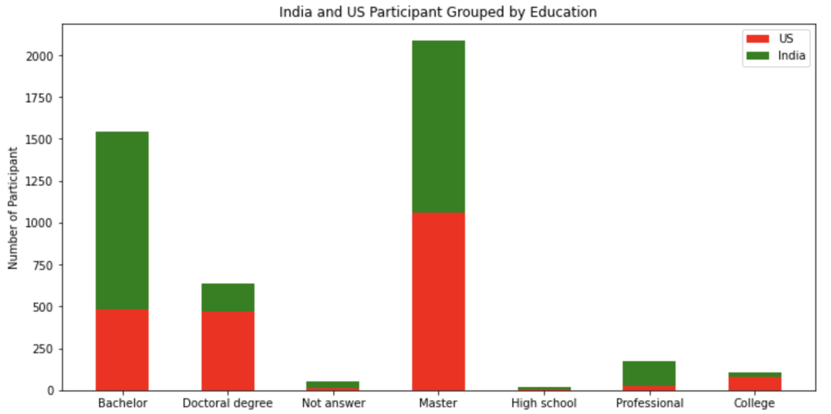
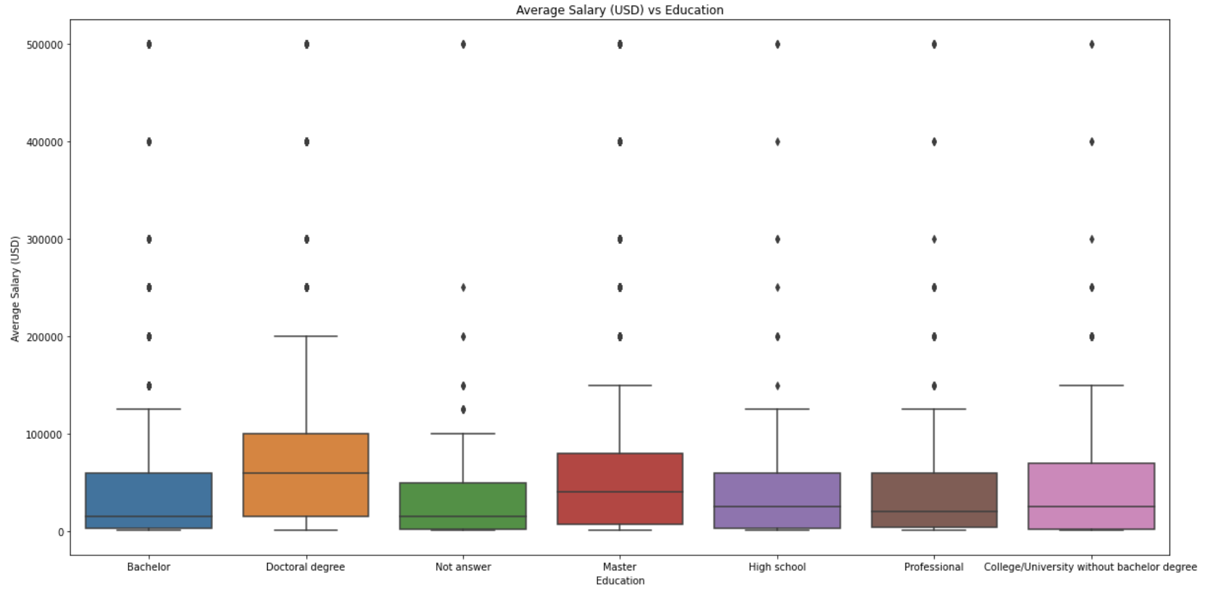
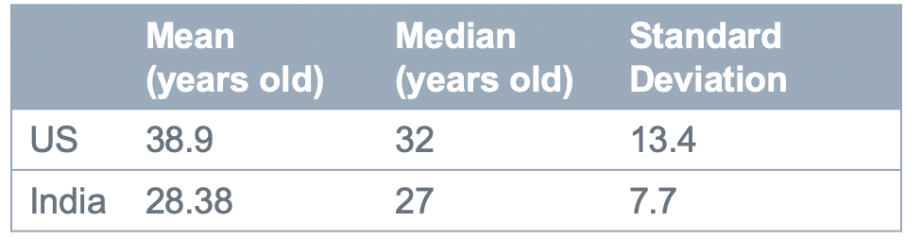
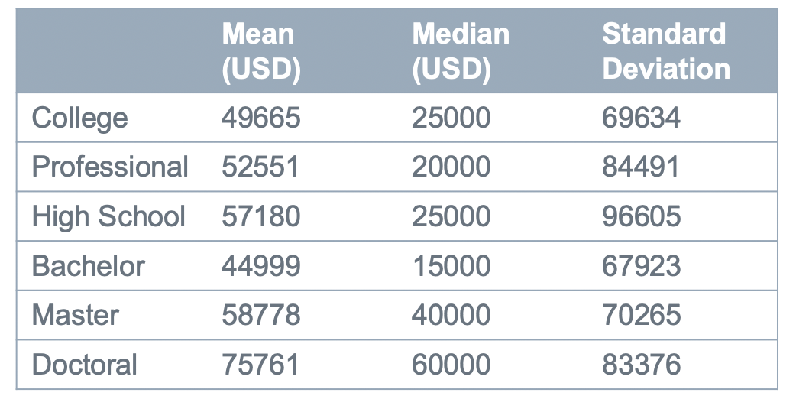
Exploratory Data Analysis
Age Group for US and India
Education Level for US and India
Mean Salary for Education
In India, over 90% participants wish or have the Bachelor and Master degree
More participants in US plan to have or already have a higher level of education than India
70% participants has Master degree or Doctoral degree in US, 50% in India for the Master degree or Doctoral degree
More than 50% of the participants come from US are 25 to 39 years old
50% of the participants in India are 22 to 29 years old
Most participants from India are in young and middle age, very few are above 40 years old
With the increasing of the level of degree the box is more stretched
Not normal distribution

Slide 3
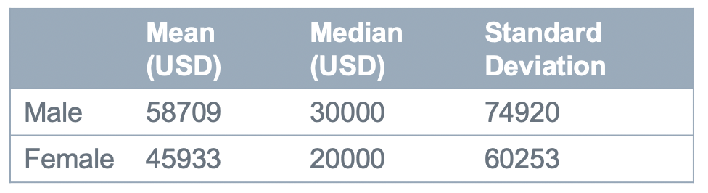
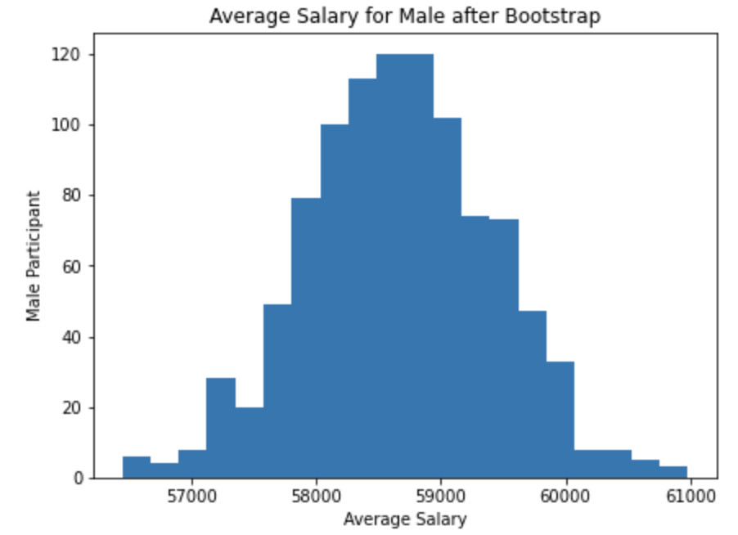
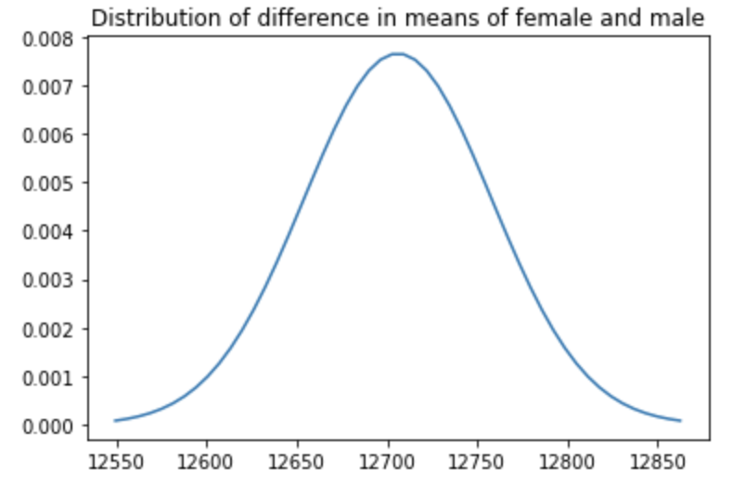
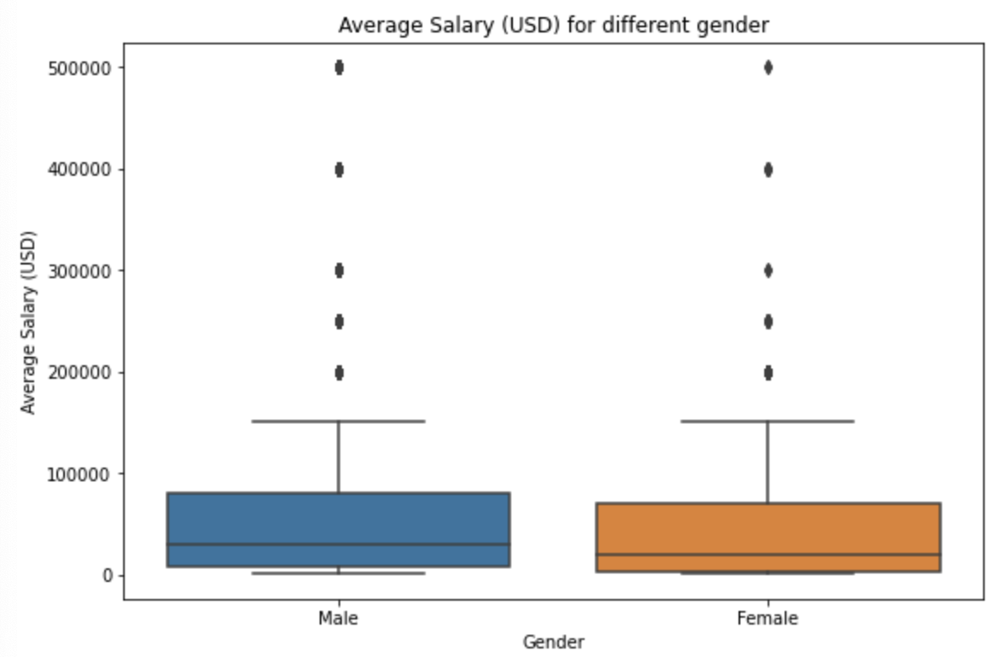
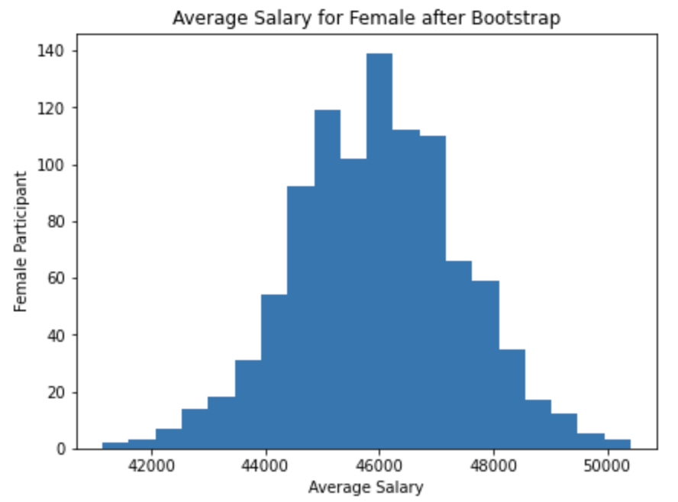
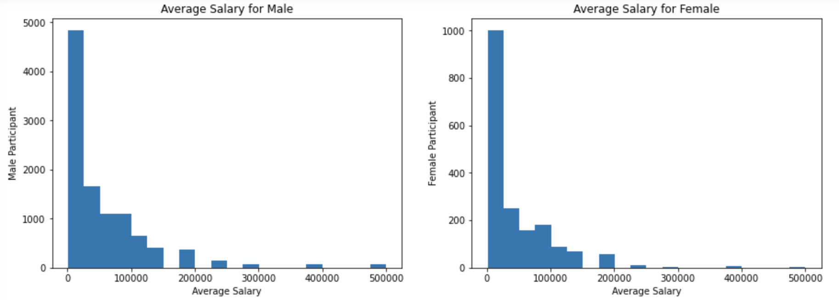
Descriptive Statistics
Bootstrap
Two-sample t-test
Difference in means of is normal distribution
Difference in average salary in male and female is statistically significant
Conclusion: average salary for male group tend to be higher than female group
Difference in mean for average salary for male and female is statistically significant
Average salary for male and female cannot apply t-test, since they are right-skewed distribution

Slide 4
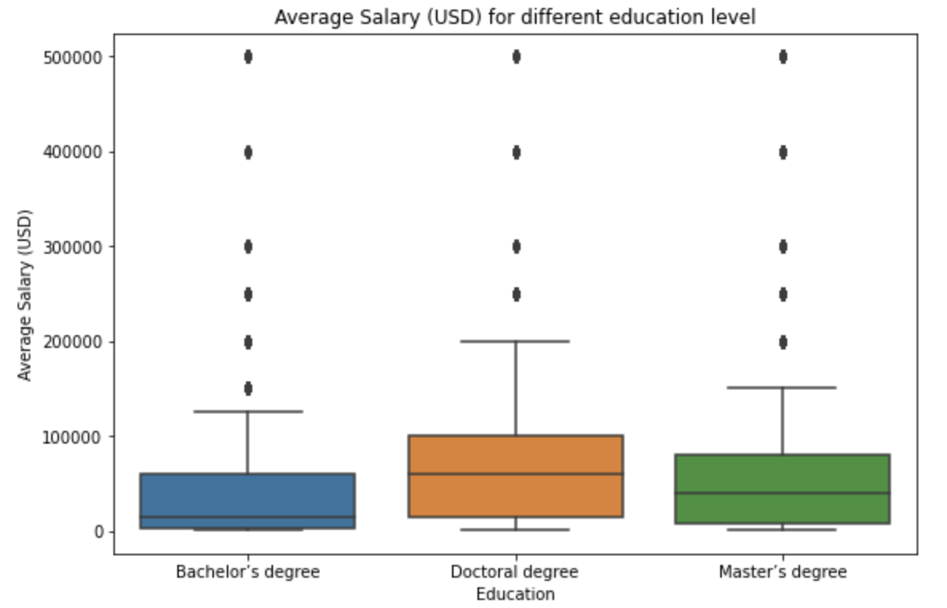
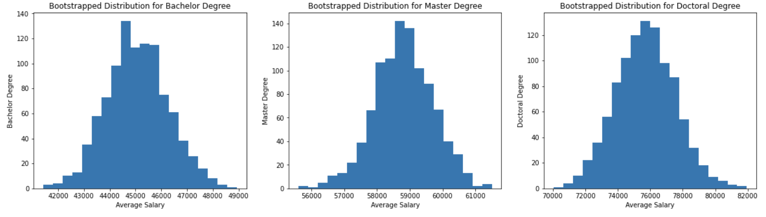
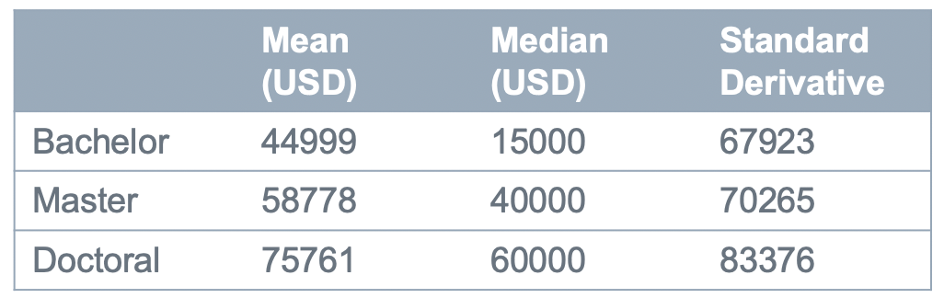
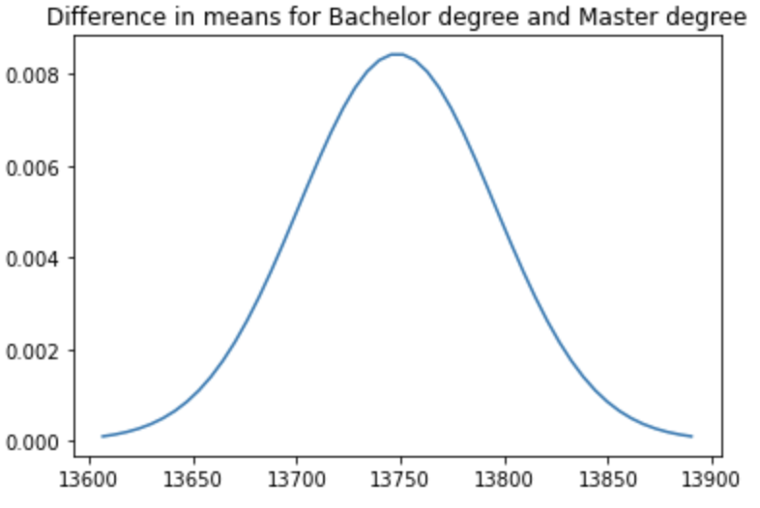
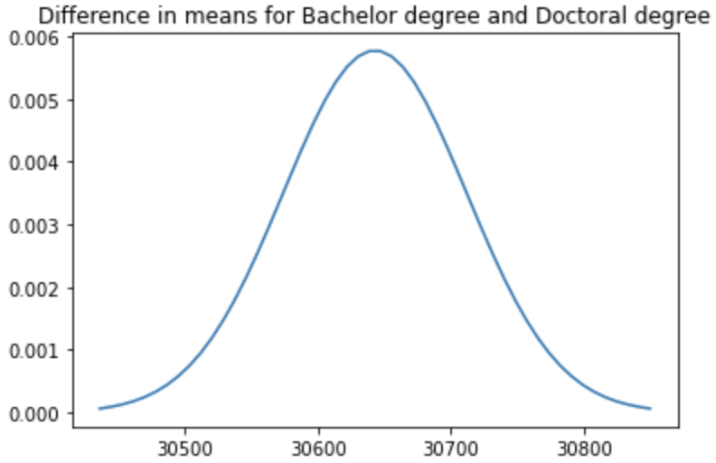
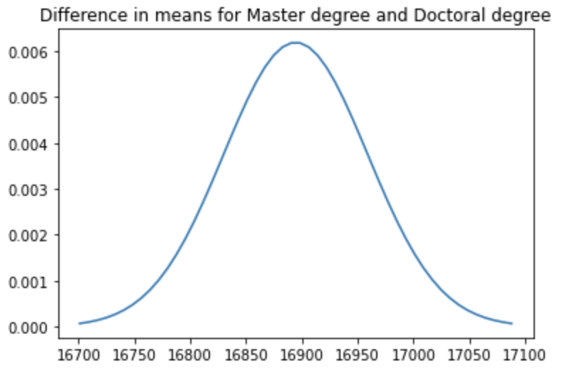
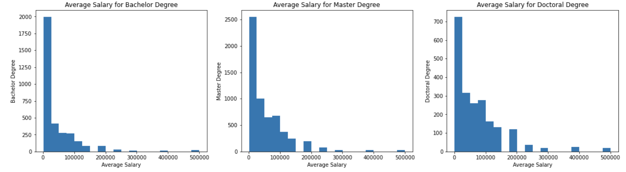
Descriptive Statistics
Bootstrap
Difference in means between each two groups are normal distribution
One-way AVOVA
Difference in mean average salary for Doctoral degree, Master degree and Bachelor degree is statistically significant
Average salary for three groups cannot apply AVOVA, they are right-skewed distribution.
Difference in average salary for Doctoral degree, Master degree and Bachelor degree is statistically significant.
Conclusion: Among these three education level, Doctoral degree earn the highest average salary, Master degree is the second highest.

